Slide 1
Lecture #4a: Multi Linear Regression and Polynomial Regression

Slide 2
Outline
Models:
Multi-regression
Interaction terms
Polynomial regression
Methods and concepts:
Bootstrap
Standard Errors
Hypothesis Testing
Confidence Intervals
One hot encoding

Slide 3
Multiple Linear Regression

Slide 4
Response vs. Predictor Variables
X
predictors
features
covariates
Y
outcome
response variable
dependent variable
TV | radio | newspaper | sales
230.1 | 37.8 | 69.2 | 22.1
44.5 | 39.3 | 45.1 | 10.4
17.2 | 45.9 | 69.3 | 9.3
151.5 | 41.3 | 58.5 | 18.5
180.8 | 10.8 | 58.4 | 12.9
n observations
p predictors

Slide 5
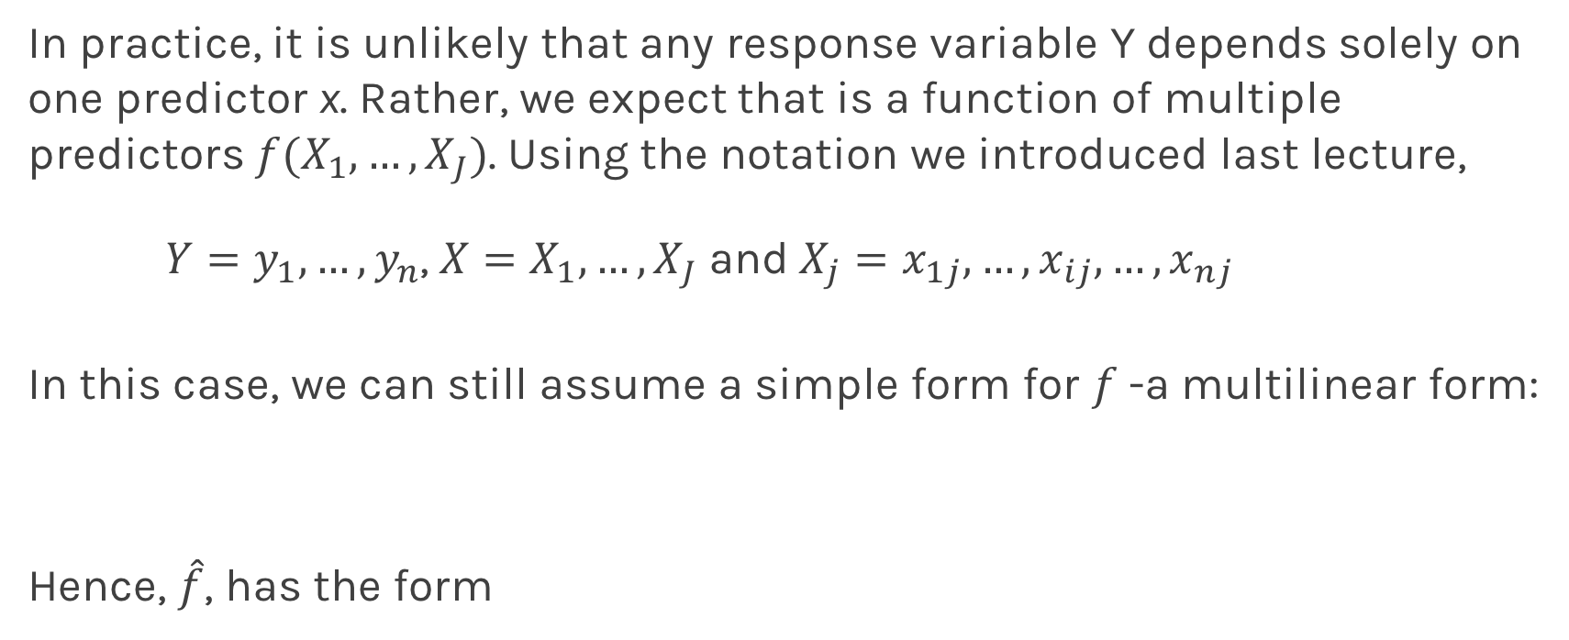
Multilinear Models
In practice, it is unlikely that any response variable Y depends solely on one predictor x. Rather, we expect that is a function of multiple predictors $f(X_{1},…,X_{J})$. Using the notation we introduced last lecture,
$Y=y_{1},…,y_{n}$, $X=X_{1},…,X_{J}$and$X_{j}=x_{1j},…,x_{ij},…,x_{nj}$
In this case, we can still assume a simple form for $f$-a multilinear form:
Hence, $\hat{f}$, has the form
Notes:
We need a figure here

Slide 6
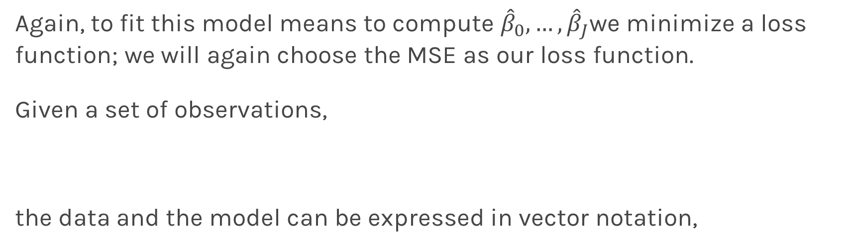
Multiple Linear Regression
Again, to fit this model means to compute ${\hat{β}}_{0},…,{\hat{β}}_{J}$we minimize a loss function; we will again choose the MSE as our loss function.
Given a set of observations,
the data and the model can be expressed in vector notation,
Notes:
We need a figure here

Slide 7
Multiple Linear Regression
The model takes a simple algebraic form:
Thus, the MSE can be expressed in vector notation as
Minimizing the MSE using vector calculus yields,
Notes:
We need a figure here

Slide 8

Finding Significant Predictors: Hypothesis Testing
For checking the significance of linear regression coefficients:
we set up our hypotheses $H_{0}$:
we choose the F-stat to evaluate the null hypothesis,

Slide 9

Finding Significant Predictors: Hypothesis Testing
we can compute the F-stat for linear regression models by
If $F=1$ we consider this evidence for $H_{0}$; if $F>1$, we consider this evidence against $H_{0}$.

Slide 10
Qualitative Predictors
So far, we have assumed that all variables are quantitative. But in practice, often some predictors are qualitative.
Example: The Credit data set contains information about balance, age, cards, education, income, limit , and rating for a number of potential customers.
Income | Limit | Rating | Cards | Age | Education | Gender | Student | Married | Ethnicity | Balance
14.890 | 3606 | 283 | 2 | 34 | 11 | Male | No | Yes | Caucasian | 333
106.02 | 6645 | 483 | 3 | 82 | 15 | Female | Yes | Yes | Asian | 903
104.59 | 7075 | 514 | 4 | 71 | 11 | Male | No | No | Asian | 580
148.92 | 9504 | 681 | 3 | 36 | 11 | Female | No | No | Asian | 964
55.882 | 4897 | 357 | 2 | 68 | 16 | Male | No | Yes | Caucasian | 331

Slide 11
Qualitative Predictors
If the predictor takes only two values, then we create an indicator or dummy variable that takes on two possible numerical values.
For example for the gender, we create a new variable:
We then use this variable as a predictor in the regression equation.

Slide 12

Qualitative Predictors
Question: What is interpretation of $β_{0}$ and $β_{1}$?

Slide 13
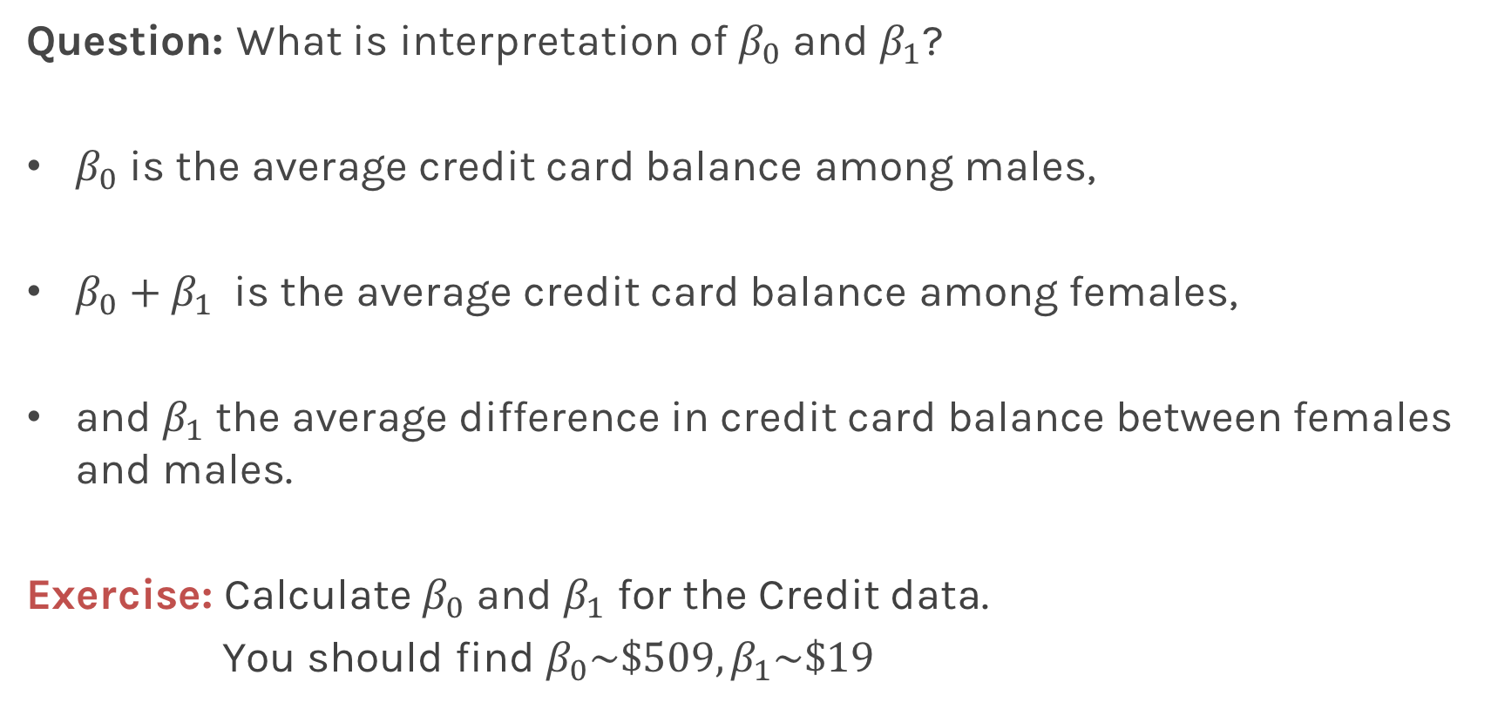
Qualitative Predictors
Question: What is interpretation of $β_{0}$ and $β_{1}$?
$β_{0}$ is the average credit card balance among males,
$β_{0}+β_{1}$ is the average credit card balance among females,
and $β_{1}$ the average difference in credit card balance between females and males.
Exercise: Calculate $β_{0}$ and $β_{1}$ for the Credit data.
You should find $β_{0}\sim \$509,β_{1}\sim \$19$

Slide 14
More than two levels: One hot encoding
Often, the qualitative predictor takes more than two values (e.g. ethnicity in the credit data).
In this situation, a single dummy variable cannot represent all possible values.
We create additional dummy variable as:

Slide 15
More than two levels: One hot encoding
We then use these variables as predictors, the regression equation becomes:
Again the interpretation
Notes:
[ADD interpretation and ONE HOT ENCODING]

Slide 16
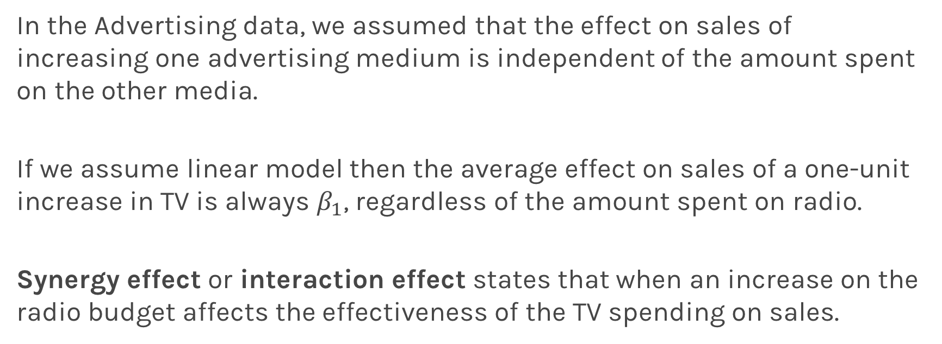
Beyond linearity
In the Advertising data, we assumed that the effect on sales of increasing one advertising medium is independent of the amount spent on the other media.
If we assume linear model then the average effect on sales of a one-unit increase in TV is always $β_{1}$, regardless of the amount spent on radio.
Synergy effect or interaction effect states that when an increase on the radio budget affects the effectiveness of the TV spending on sales.

Slide 17
Beyond linearity
We change
To

Slide 18
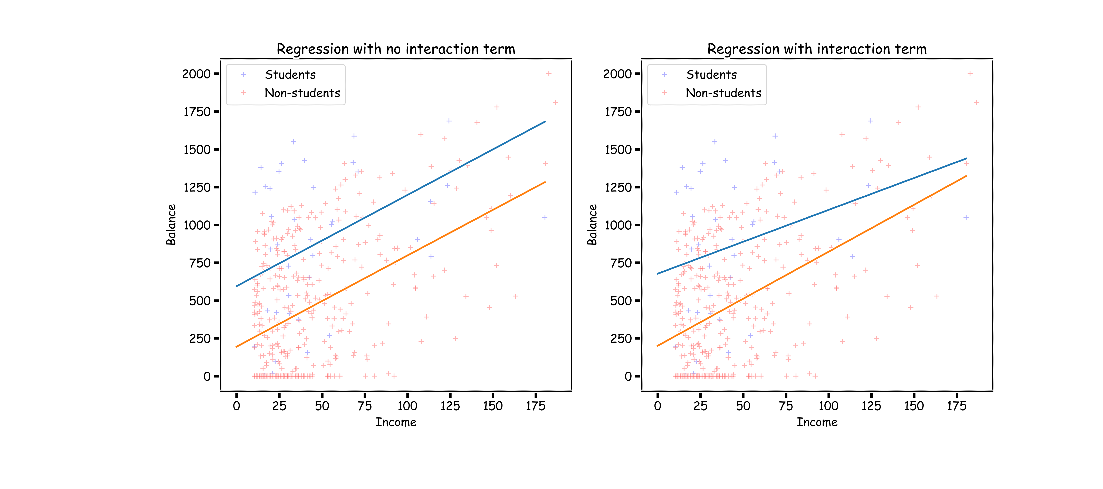
What does it mean?

Slide 19
Predictors predictors predictors
We have a lot predictors!
Is it a problem?
Yes: Computational Cost
Yes: Overfitting
Wait there is more …

Slide 20
Polynomial Regression

Slide 21
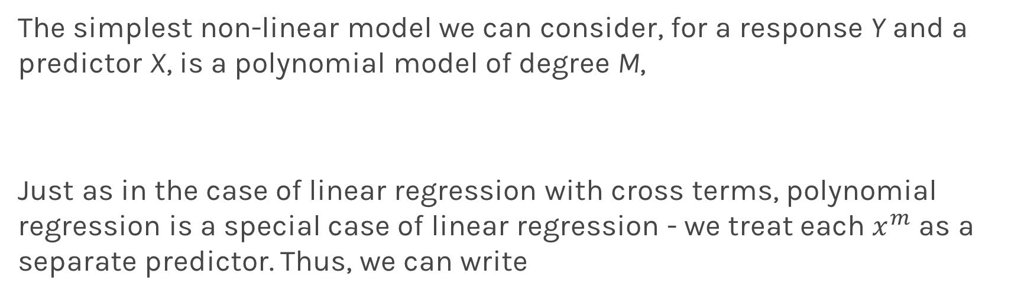
Polynomial Regression
The simplest non-linear model we can consider, for a response Y and a predictor X, is a polynomial model of degree M,
Just as in the case of linear regression with cross terms, polynomial regression is a special case of linear regression - we treat each $x^{m}$ as a separate predictor. Thus, we can write

Slide 22
Polynomial Regression
Again, minimizing the MSE using vector calculus yields,

